Slide 1


Slide 2


Slide 3
Mitch Rule
If you don’t know something, admit it, and find someone who does know

Slide 4
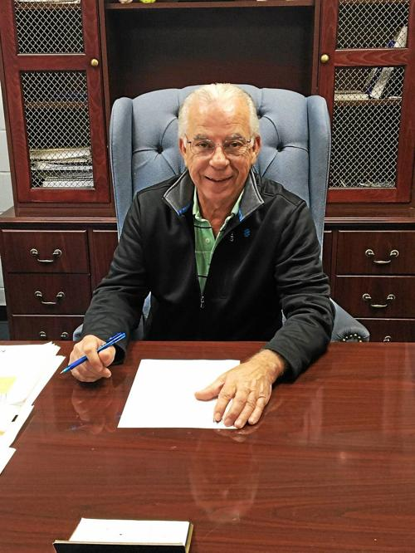

Slide 5
Mr. Johnson Rule
Don’t go into retail

Slide 6

Special Ed. Srvs to School Districts

Slide 7
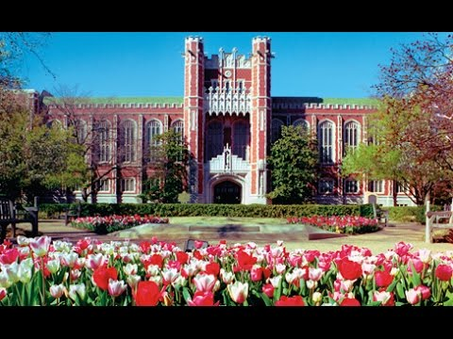
Oklahoma University

Slide 8

Applied the “Mr. Johnson Rule”.

Slide 9
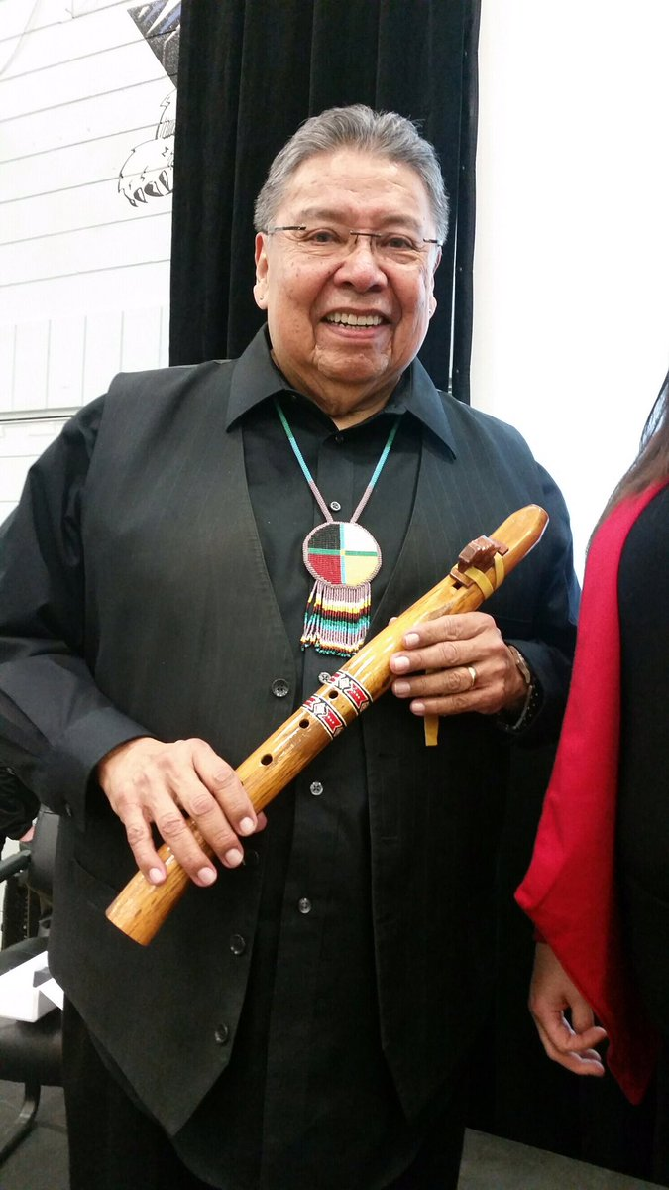
Dr. Martin Brokenleg

Slide 10
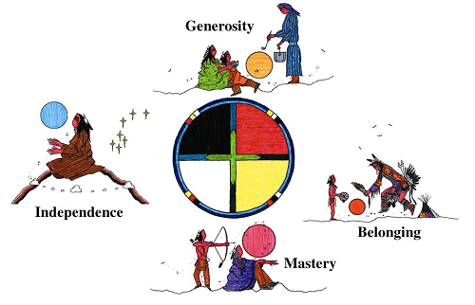
Circle of Courage Philosophy

Slide 11
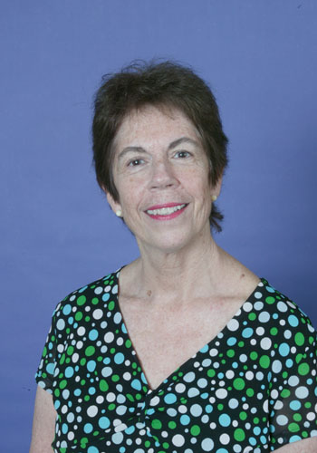
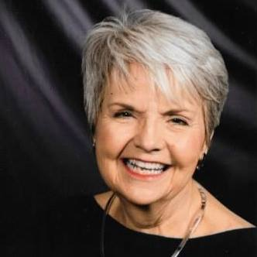
Using the “Mitch Rule”
Dr. Allene B. Booth
First Superintendent
Dr. Susan Perez
First Principal

Slide 12
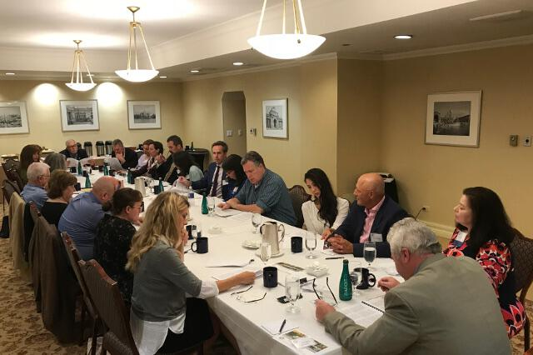
Applied for School Charter to the State Board of Education

Slide 13

To create new and innovative school choice opportunities in Central Texas
Mission Statement

Slide 14
To be a leader in the school choice movement
Vision Statement

Slide 15
Values
Circle of Courage
Philosophy
Belonging
Mastery
Independence
Generosity

Slide 16
1995 - 2020 Accomplishments

Slide 17
5 campuses
1995 - 2020 Accomplishments

Slide 18
5 campuses
2,000 students
1995 - 2020 Accomplishments

Slide 19
5 campuses
2,000 students
$20 M budget
1995 - 2020 Accomplishments

Slide 20
5 campuses
2,000 students
$20 M budget
One of the top ranked school districts in Texas
1995 - 2020 Accomplishments

Slide 21
5 campuses
2,000 students
$20 M budget
One of the top ranked school districts in Texas
One of the top ranked high schools in Texas
1995 - 2020 Accomplishments

Slide 22
5 campuses
2,000 students
$20 M budget
One of the top ranked school districts in Texas
One of the top ranked high schools in Texas
“One of the most beautiful campuses in TX”
1995 - 2020 Accomplishments

Slide 23
5 campuses
2,000 students
$20 M budget
One of the top ranked school districts in Texas
One of the top ranked high schools in Texas
“One of the most beautiful campuses in TX”
Students who have excelled
1995 - 2020 Accomplishments

Slide 24

Our People
Executive Team

Slide 25

Our Emperor

Slide 26
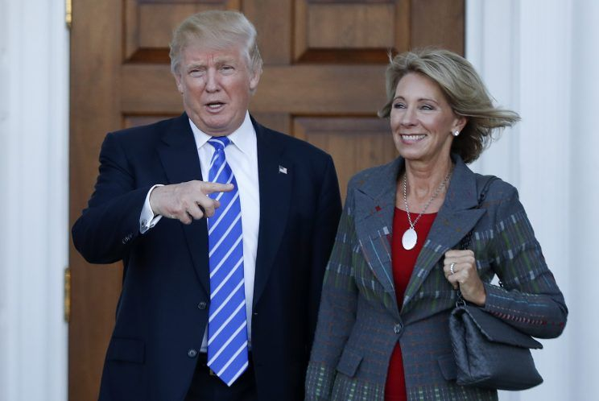
State of Public Ed at Federal Level

Slide 27

2020 Democratic Party Platform

Slide 28


Slide 29
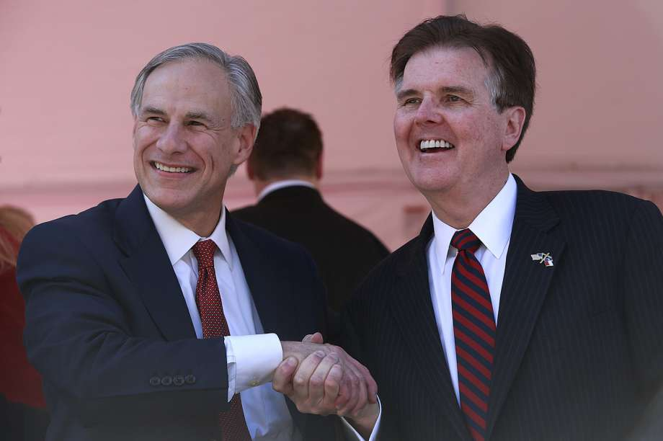
State of Public Ed in Texas

Slide 30
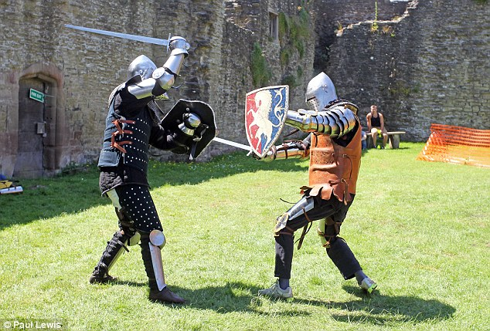
Public Charter Schools Must Protect Their Gains

Slide 31
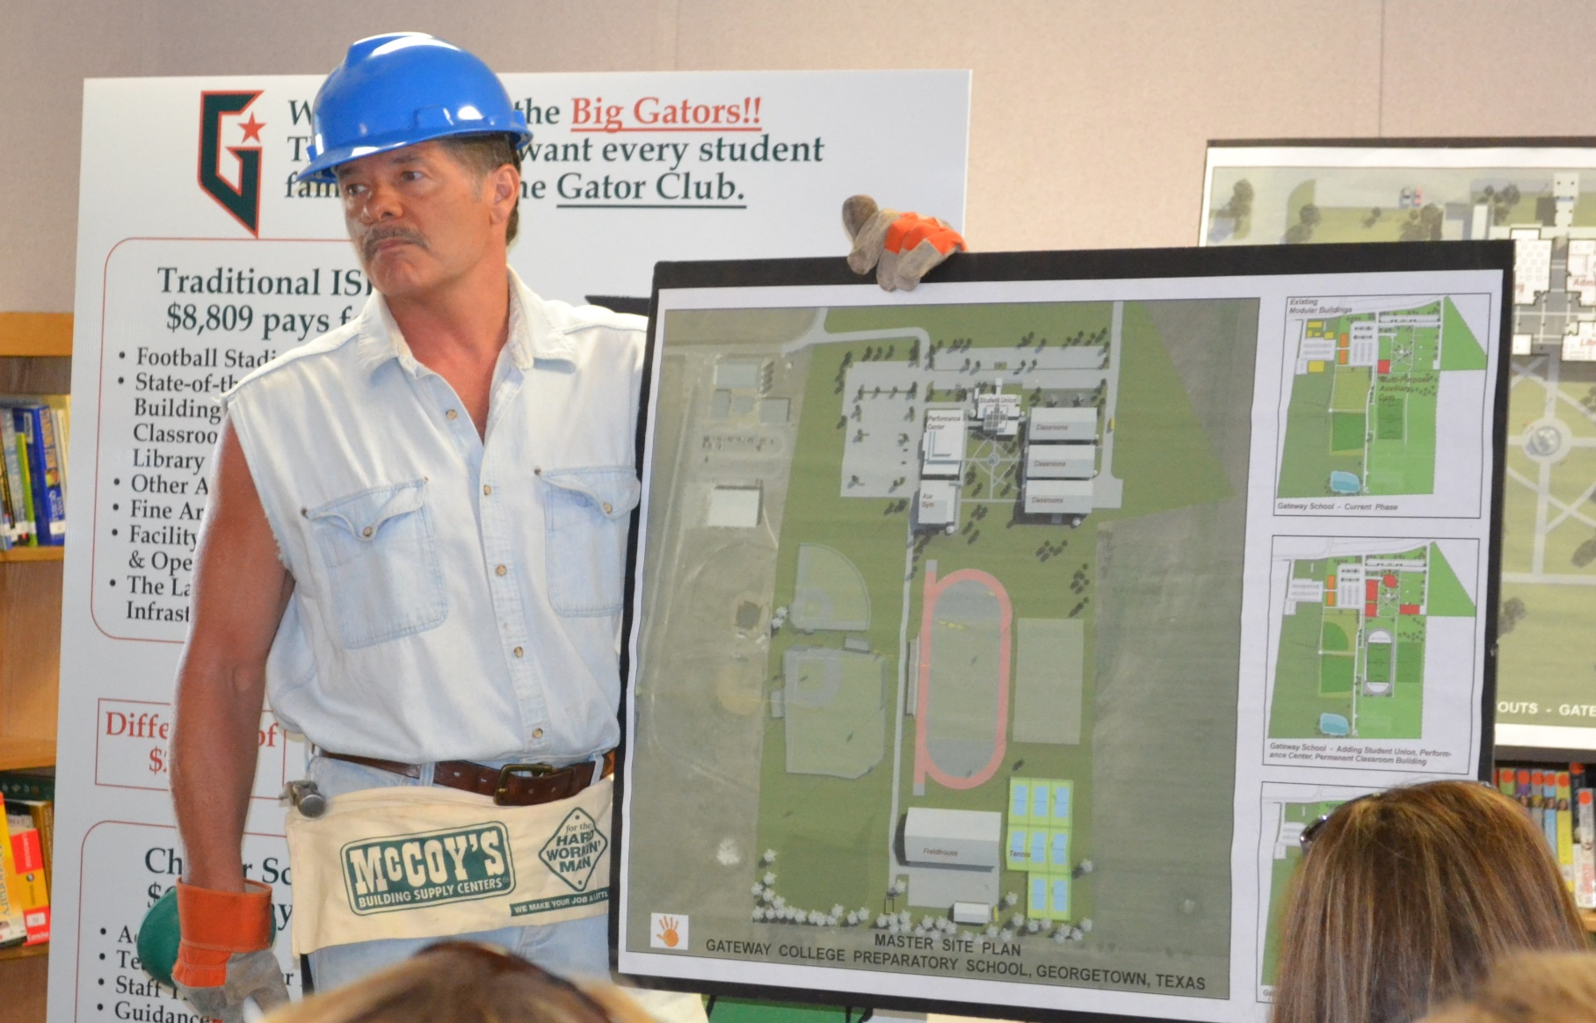
State of Public Ed at Orenda

Slide 32

Yikes!!!!!

Slide 33

Tax payers pay us to educate, not indoctrinate

Slide 34

School Year 2019-20 Goals
REVIEW

Slide 35
School Year 2019-20 Goals
District Wide Enrollment Reaches 1,900

Slide 36
School Year 2019-20 Goals
District Wide Enrollment Reaches 1,900
    We had 1,816

Slide 37
School Year 2019-20 Goals
Raise $600,000 in charitable contributions

Slide 38
School Year 2019-20 Goals
Raise $600,000 in charitable contributions
We raised $515,000

Slide 39
School Year 2019-20 Goals
Implementation of Leadership Succession Plan

Slide 40
School Year 2019-20 Goals
Implementation of Leadership Succession Plan
Carla Silber was appointed Superintendent last September. Mr. Rickey appointed to the OE board and remains as CEO full-time through May, 2022.

Slide 41
School Year 2019-20 Goals
Successfully implement phase 2 of our distance learning innovation project

Slide 42
School Year 2019-20 Goals
Successfully implement phase 2 of our distance learning innovation project
We abandoned the project. The cost-benefit ratios were negative.

Slide 43
School Year 2019-20 Goals
Complete the written Master Plan & secure funding for the new Gateway south campus

Slide 45
School Year 2019-20 Goals
Complete the written Master Plan & secure funding for the new Gateway south campus
Pandemic economic fall out changes this plan.
Delay opening this new school until at least 2024.
Named Gateway School of Arts & Sciences K – 8.

Slide 46
Strategic Plans for 2020-21 & Beyond

Slide 47

Key Targets

Slide 48
STAAR scores better than nearest ISD public school

Slide 49
STAAR scores better than nearest ISD public school
Gateway Prep ranked in top 50 in Texas by US News and World Report, top 10 in Austin area

Slide 50
STAAR scores better than nearest ISD public school
Gateway Prep ranked in top 50 in Texas by US News and World Report, top 10 in Austin area
100% of our graduating seniors from our college prep campuses pass at least one AP exam

Slide 51
STAAR scores better than nearest ISD public school
Gateway Prep ranked in top 50 in Texas by US News and World Report, top 10 in Austin area
100% of our graduating seniors from our college prep campuses pass at least one AP exam
SAT ave. score of 1200 for all college bound seniors

Slide 52
STAAR scores better than nearest ISD public school
Gateway Prep ranked in top 50 in Texas by US News and World Report, top 10 in Austin area
100% of our graduating seniors from our college prep campuses pass at least one AP exam
SAT ave. score of 1200 for all college bound seniors
ACT ave. score of 25 for all college bound seniors

Slide 53
“Superior Achievement” – Financial Integrity Rating System of Texas (“FIRST”)

Slide 54
“Superior Achievement” - F.I.R.S.T. rating
BBB + Standard & Poor’s global bond rating

Slide 55
“Superior Achievement” - F.I.R.S.T. rating
BBB + Standard & Poor’s global bond rating
First charter school to win the UIL “Lone Star Cup” or Austin American-Statesman “Breazeale Cup” for athletic achievements

Slide 56
Strategic Plans for 2020 and Beyond

Slide 57


Grow Enrollment – Improve Scores
Kingsland School
Nolan Creek School

Slide 58


Continue what you are doing
New Horizons School
Gateway Tech School

Slide 59

Expand enrollment from wait list grades 6 – 8
Gateway Prep School

Slide 61
Strategic Plans for 2020 and Beyond
August 2021 > Open Future 9th Grade Center at GCPS (starting w. middle school wait list students)

Slide 62
Strategic Plans for 2020 and Beyond
August 2021 > Open Future 9th Grade Center at GCPS (starting w. middle school wait list students)
March 2023 > Begin construction of the new Gateway School of Arts & Sciences (K-8)

Slide 63
Strategic Plans for 2020 and Beyond
August 2021 > Open Future 9th Grade Center at GCPS (starting w. middle school wait list students)
March 2023 > Begin construction of the new Gateway School of Arts & Sciences (K-8)
August 2024 > Open Gateway School of Arts & Sciences

Slide 64
Strategic Plans for 2020 and Beyond
August 2021 > Open Future 9th Grade Center at GCPS (starting w. middle school wait list students)
March 2023 > Begin construction of the new Gateway School of Arts & Sciences (K-8)
August 2024 > Open Gateway School of Arts & Sciences
Five years from now > Operate 6 campuses w 3,000 students

Slide 65
Strategic Plans for 2020 and Beyond
August 2021 > Open Prep 200
March 2023 > Begin construction of the new Gateway School of Arts & Sciences (K-8)
August 2024 > Open Gateway School of Arts & Sciences
Five years from now > Operate 6 campuses w 3,000 students
Ten years from now > Operate 7 campuses w 4,000 students

Slide 66

Promoting Courage In Our Students

